Slide 1
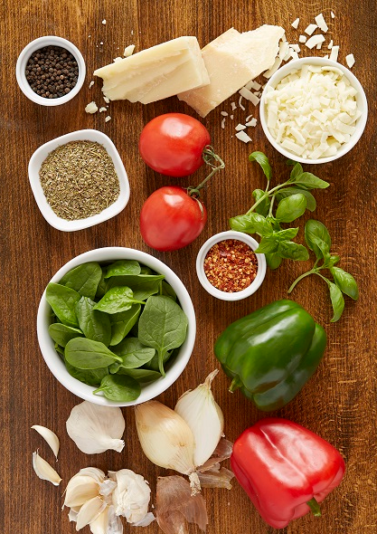
Introduction
Our goal is to better understand which offers should be promoted to which customers via coupon mailers
We previously segmented customers based on their transactional history to determine coupon sets that best fit each segment
We now aim to devise a method of customer target selection in order to maximize the return on marketing spend

Slide 2
Data Preparation
Data set used: January – March 2016 set of mailed and control customers with their response information (Purchased within 4 weeks/ Did not purchase within 4 weeks)
Attached transactional segmentation information discussed in our previous presentation
Put any customer that had no transactional segment into an 11th segment, Unknown
Found the average number of items ordered per visit for each customer in the previous quarter
Coded any customer without previous order information with 2.72, the average of all customers average items

Slide 3
Transactional Segmentation
Food Aficionado – Tends to get a large specialty pie or a large with multiple toppings. Generally order for dinner.
Soda Lover, Light on Food – 2 top hand tossed medium side order about 1/2 time dinner or late night, not heavy on lunch orders. Tend to order soda.
Passive Customer – Avg. 1 pizza slightly below ½ time for side orders, usually medium or large, trend towards lunch orders over dinner orders.
Large Pizza for Dinner – 1-2 large pizzas often on Friday night for dinner.
2 Medium Sized Pies – 2 pizzas generally medium.

Slide 4
Transactional Segmentation Cont.
Side Bread Consumer – Tend to order med pizza and bread side. just about always order a side generally order for dinner
Pizza only With Chicken – 2 med pizza generally hand tossed, always order a side, generally chicken order at dinner time
Readymade Meal Seeker – 1 hand tossed medium pie, frequent orderers, order during work week
Chicken Hunter – Order for chicken, pizza is an afterthought
Weekend Pizza Party – Frequent weekend orderers, 1 medium order sides about 1/2 time almost even mix of what they order for the side primarily dinner orders
Segment Unknown – This group is all customers whose transactional segment is unknown

Slide 5
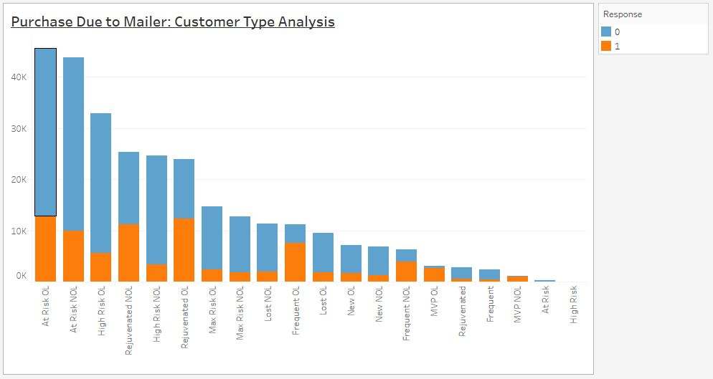
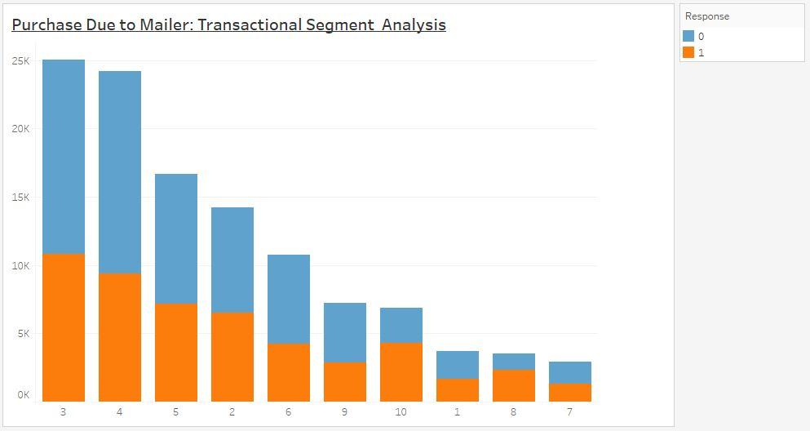
Purchase Due to mailer by Group Membership
Customer Type is the recency segmentation already in use
Transactional Segments are shown as the segmentation number defined earlier in our presentation.
Segment 11, or Unknown, has been excluded from current graph. It had 170,270 members total and 31,838 purchases for a rate of 18.7%

Slide 6
Model – Logistic Regression
The following model was transformed using logistic regression to find each customer’s individual probability of purchasing within 4 weeks of receiving a mailer:
Purchase =
Customer Type +
Transactional Segment +
Average Total Items +
Number of Adults +
Number of Children

Slide 7
Exploratory Test
Our model was created using only customers who were sent a mailer
We wanted to understand the effect of receiving a mailer vs not receiving a mailer.
We created a second model using the same variables, adding mailed as a variable to test this effect.
The odds ratio of this estimate was 3.128, indicating that receiving a mailer has a strong effect of the predicted probability

Slide 8
Goodness of fit
Model Fit Statistics indicated that the model is stronger than both
A lack of model
&
A model created from only Dominos Customer type
All variables were found to be significant at P < 0.01
33 of 34 point estimates were found to be significant at P < 0.01, 1 point estimate was significant at P < 0.10

Slide 9
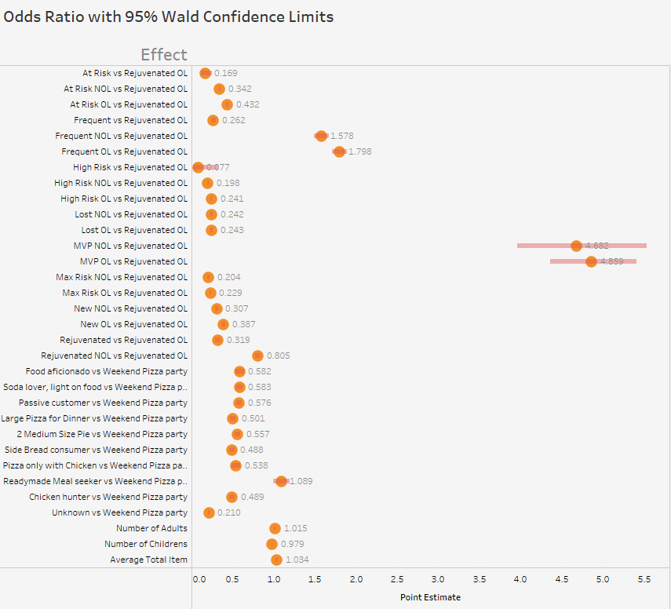
Odds Ratio Point Estimates w/ confidence intervals

Slide 10
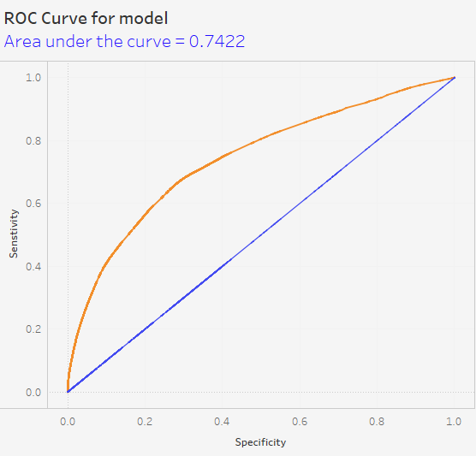
ROC CURVE

Slide 11
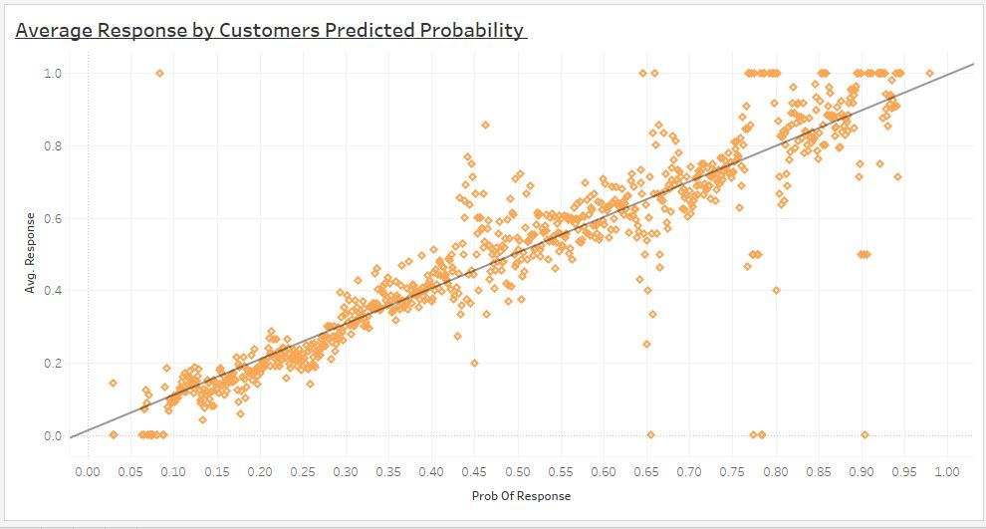

Slide 12
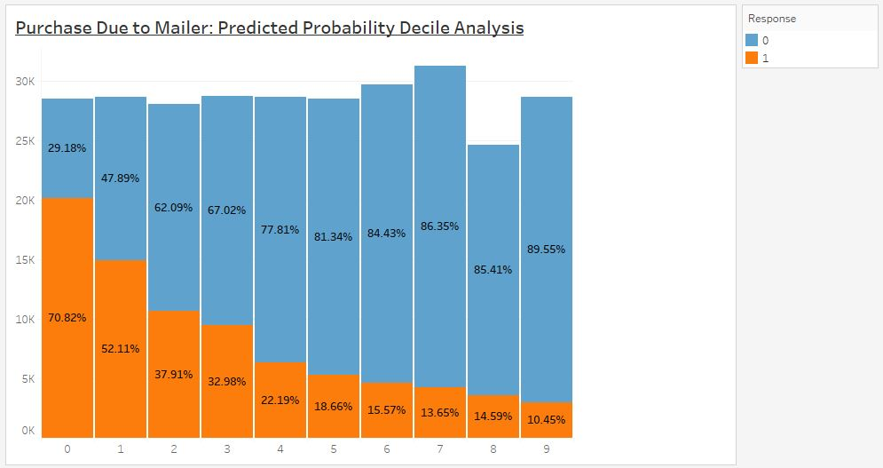

Slide 13
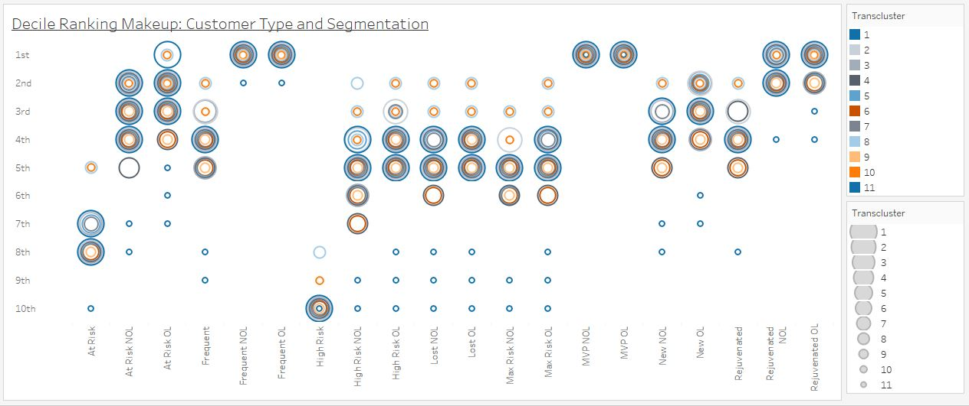

Slide 14
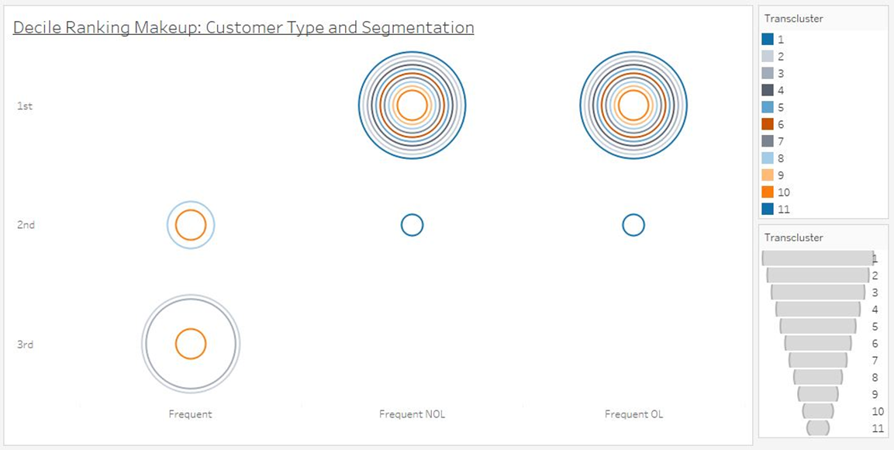

Slide 15
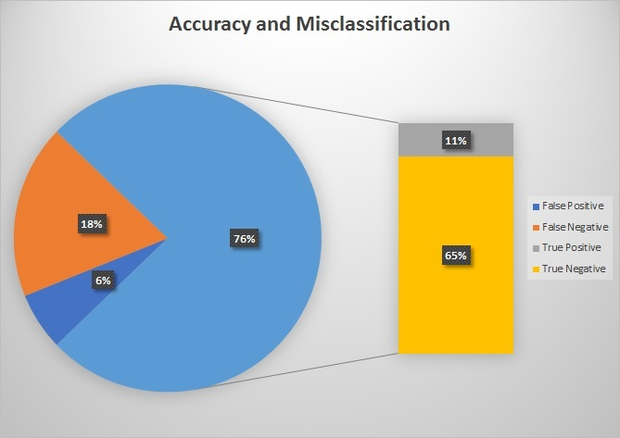
Accuracy and Misclassification
False Negative rate is currently higher than the True Positive
56.96% of False Negatives are in the Unknown segment
Probability cutoff for this test was set to .50

